Slide 1

Resumate
Week-5 Group-7
Saud| Anika| Sakia | Rima
North South University | 2025

Slide 2
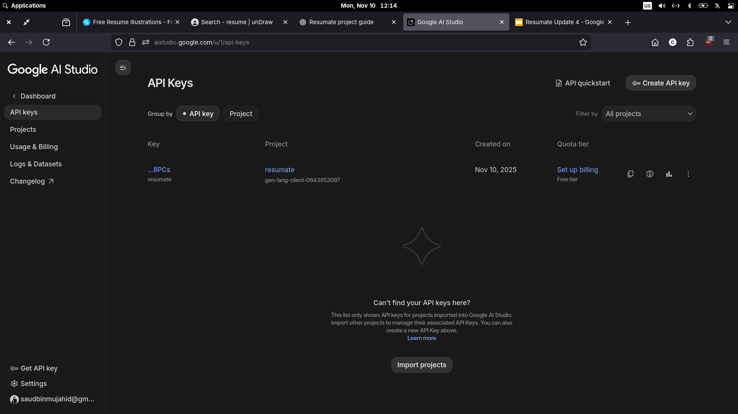
1
API creation

Slide 3
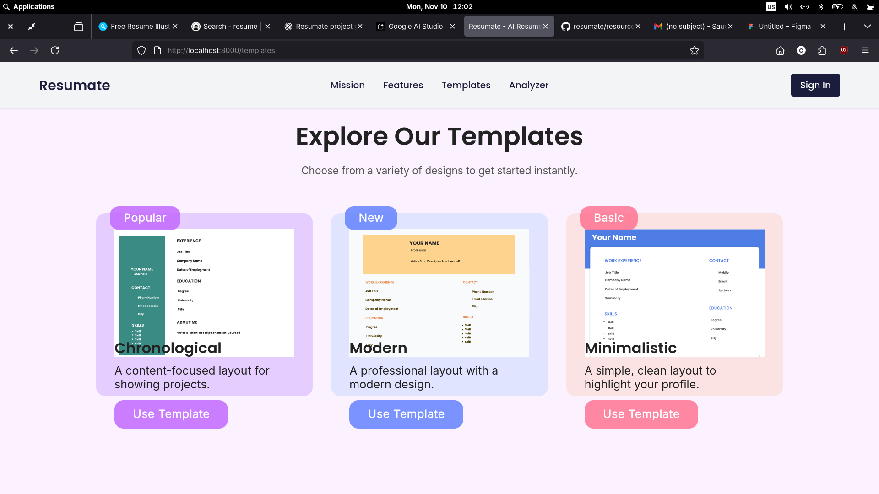
1
Templates update

Slide 4
1
Resumate
Focus on Simplicity and Transparency: Resumate prioritizes an intuitive, minimal interface dedicated solely to resume creation.
Free Essential Features: Core functions like AI text generation, editing, and PDF export will remain free and accessible, especially for students and early-career users.
No Unnecessary Distractions: Unlike other platforms, Resumate avoids job tracking or unrelated integrations, keeping the user experience focused.
Peer & Recruiter Feedback Loop: Integrates a machine learning-powered feedback system, gathering insights from real-world hiring data.
ATS-Friendly and Visually Appealing: Helps users create resumes that are both ATS-optimized and visually attractive.
Actionable Insights: Provides meaningful feedback on how to improve resumes, beyond just formatting and keywords.
Affordable & Personalized: Aims to address the gaps in usability, affordability, and personalization seen in existing AI resume builders.
Community-Driven Evaluation: Incorporates real-world feedback to make resume creation more effective and approachable for users at all career stages.

Slide 5
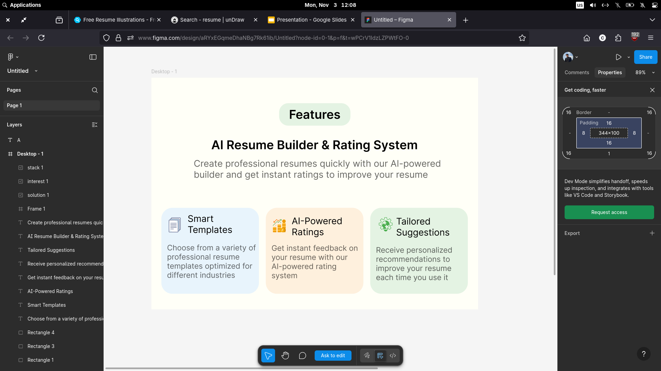
1
Figma

Slide 6
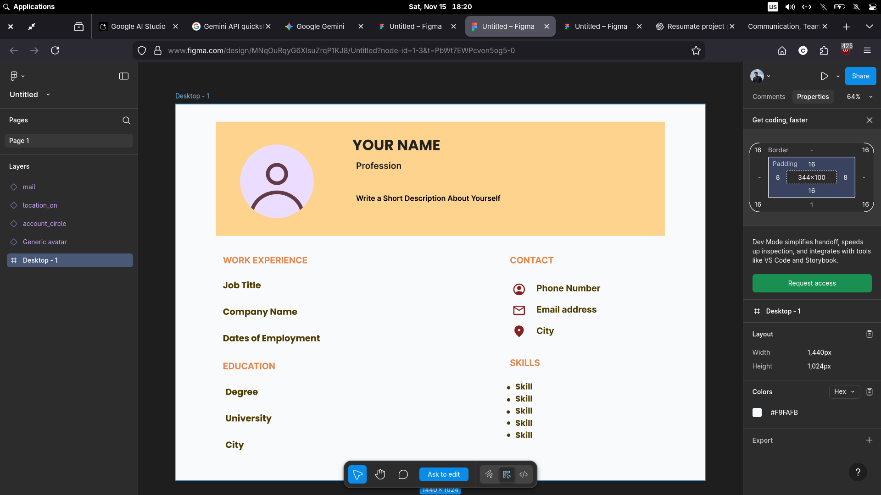

Slide 7
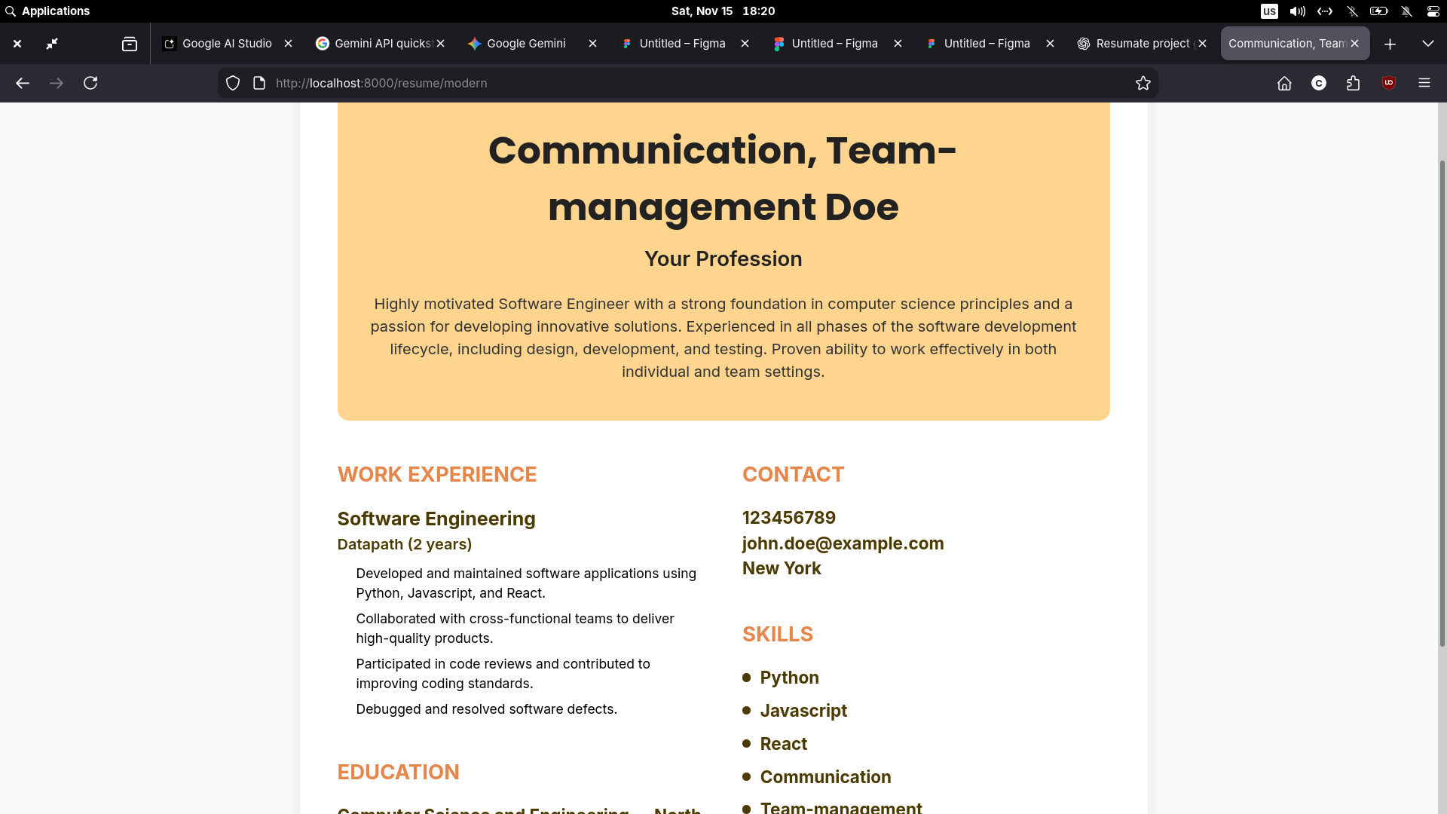

Slide 8
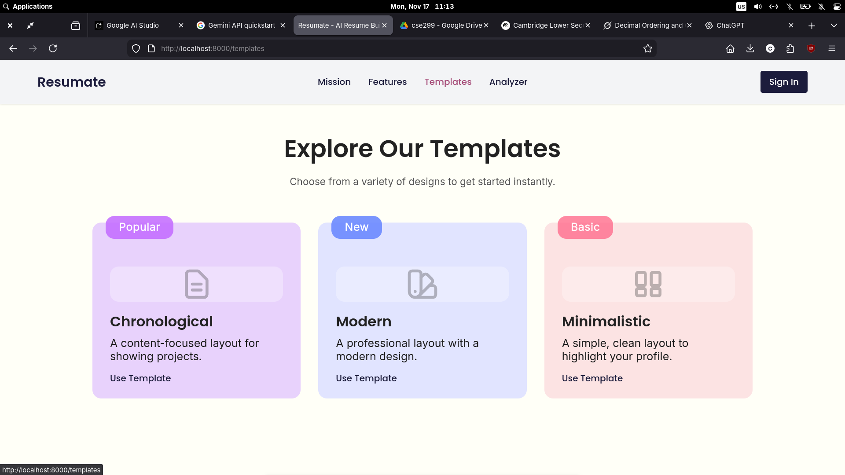

Slide 9
Thank You

